Slide 1
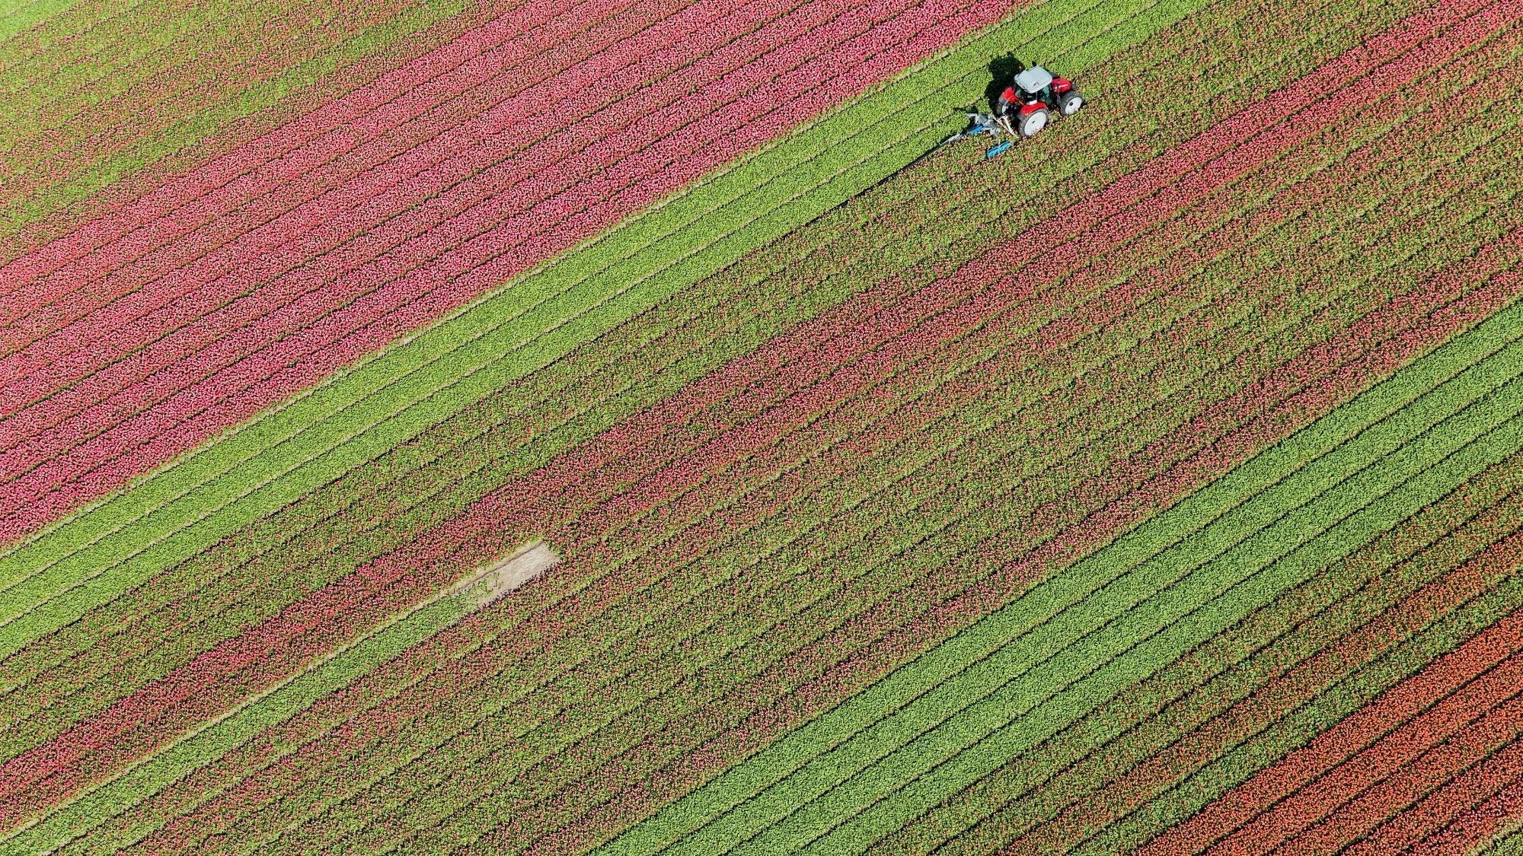

Swarm Robotics ABM Simulation in Agriculture
Final Video
Team: Bethlehem B. Bethun B. Tousif S.

Slide 2
Agenda
Introduction
Project Summary
Background Context
Previous Work Review
Target vs Stretch Goals
Key Results
Methodology
Demo
Data Analysis
Conclusion
Potential Next Steps

Slide 3
Introduction

Slide 4
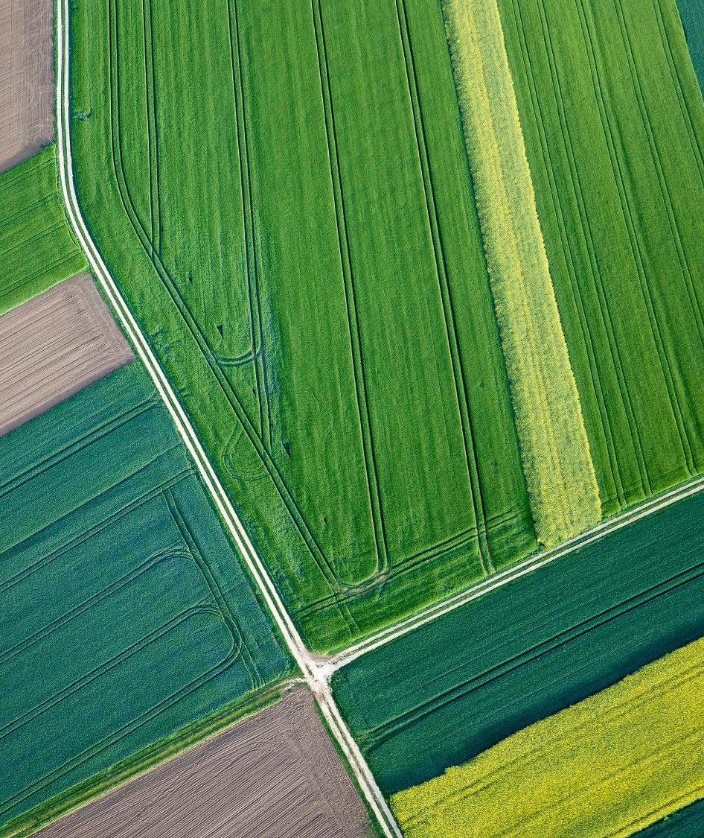
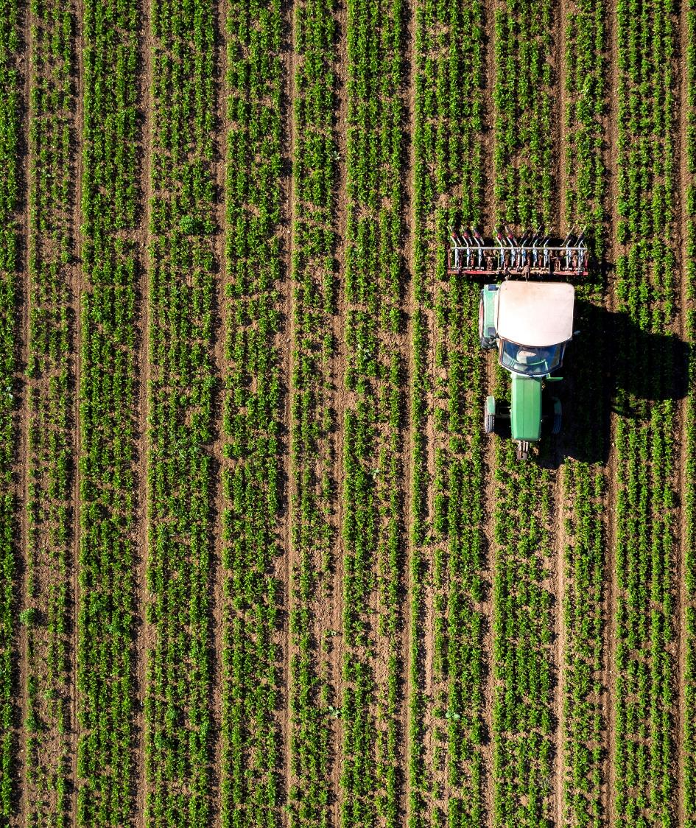



Our Team
Bethlehem B.
Bethun B.
Tousif S.
Notes:
Our group consists of ALM students of different programs with business, technology and design backgrounds.
We broke down the individual roles and responsibilities to align to our respective skills, but still maintained a strong collaborative relationship over the course of the semester to see the Term Project to completion.

Slide 5
Project Summary
Agent-Based simulation algorithm of Swarm Robotics to improve crop yields.
Algorithm focus:
drone and ground robots communication efficacy
path planning, optimization, and coordination
weed detection and correction
Used Netlogo to achieve this.
Notes:
We built a Particle Swarm Optimization simulation algorithm of Swarm Robotics for ground robots and drones in an Agent-Based Model to improve crop yields.
The algorithm focuses on:
efficiency and effectiveness in communication between the drones and ground robots
path planning, optimization, and coordination
weed detection and correction
The project will explore scenarios with ground-only swarm robots and a combination of ground and aerial vehicles, using the Netlogo for agent-based modeling (ABM).
Note on Changes:
Initially we had planned Weed Detection/ Plant disease identification, however, in the simulation we have added Weed Correction mechanism which removes weed in the simulation.
We also used Netlogo instead of Python MESA as we had difficulty in navigating through the coding and visualization with Python MESA

Slide 6
Background Context
Context:
Swarm robotics in agriculture maximize crop yields via precision farming
Communication between ground robots and drones allows tasks to be executed faster.
Precision farming minimizes environmental impact compared to traditional techniques.
Objectives and Importance:
Assessing efficiency of swarm communication, path planning, optimization, and coordination.
Exploring integration of ground and aerial swarm robots for enhanced agricultural operations.
Solve for weed detection and plant disease identification via Agent Based Modeling (ABM)
Market size of agricultural robotics is $15 Billion (2022) and projected at $40 Billion by 2028.
Notes:
Our project has real world applications for advancement of automating farming practices, optimizing resources, and reducing the environmental footprint of agricultural activities.

Slide 7
Previous Work Review
Literature Review Summary:
Our literature review covers articles and research papers that focus on the application of swarm robotics and artificial intelligence in agriculture:
Challenges of integrating swarm robotics into mechanized agricultural operations, emphasizing the need for research in this field (Albiero et al, 2022)
Overview of reinforcement learning applications in swarm robotics (​Akhloufi and Blais, 2023) ​​.
Multi-agent path planning for robotic swarms in agricultural fields (Botteghi et al. 2020)
Agent-based approaches and review simulators, platforms, and applications of swarm robotics, respectively, showcasing the potential of cooperative swarm robotics in agriculture (Bunte (2021) and Calderón-Arce et al. (2022)) ​​​​
Data Set Overview:
The dataset review encompasses a variety of resources aimed at advancing agricultural technologies through image analysis and machine learning.
Olsen's DeepWeeds dataset provides images for multiple weed species, facilitating the development of deep learning models for weed identification​
Dataset for date fruit to facilitate research in intelligent harvesting, (Altaheri et al. 2019)
The cwfid dataset offers a comprehensive crop/weed field image collection, designed for distinguishing between crops and weeds​​.
Menber's GitHub repository presents a dataset coupled with a convolutional neural network (CNN) approach for detecting anomalies in crops
Note: Please refer to Appendix for detailed Literature and Data Set References

Slide 8
Target vs Stretch Goals
Target Goal
Coordinating ground robots and drones for weed detection
Path planning for ground swarm robots with Particle Swarm Optimization (PSO) algorithm
Enable aerial drones to survey for the weeds and update the best positions for the ground robots
Stretch Goal
Rescue operations for stuck robots
Integrating aerial vehicles in simulation for more complex tasks
Train agents to detect weed and diseased plants in soya beans using tools such as TensorFlow
Integrate with NetLogo for testing and analysis
Simulation of Weed Removal
Determine energy consumption to determine efficiency
On Target
Limited time availability to implement
Notes:
Target Goal
Explore coordination in the ground robots and drones for successful weed detection on datasets of soybean plants
Successfully simulate communication and basic path planning for ground swarm robots to explore Particle Swarm Optimization (PSO) algorithm
Enable coordination between the ground robots and aerial drones for defined use cases
Stretch Goal
Implementing advanced coordination strategies, like rescue operations for stuck robots, and integrating aerial vehicles into the simulation for complex tasks
Training agents to detect weed and diseased plants in soya beans using tools such as TensorFlow and integrate with NetLogo code for testing and analysis
Simulation of Weed Removal
Determine energy consumption to determine efficiency

Slide 9

Key Results
PSO algorithm successfully achieved targets goals for:
navigation
path optimization
coordination of ground robots and drones
Main Findings:
larger search radii and drone amounts, more energy spent
higher density of plants and weeds, more energy required and affects weed detection rates
higher ground robots inertia, smaller number of steps to identify weeds
more swarm robots, more area covered (may be inefficient)
Notes:
We set up the simulation in NetLogo with the virtual representation of an agricultural field divided into patches that can either contain weeds, crops, or be empty. After several rounds of iteration, debugging and collaboration, we landed on a final version of the simulation that had these takeaways.
First, <PSO>
We also ran tests in the NetLogo Behaviorspace which gleaned valuable insights on the trade-offs between search thoroughness, energy efficiency, and robot responsiveness. The key findings are <findings>
Inertia affects the movement patterns and response rates of the robots.
Increased robot populations cover more area but may also lead to increased energy consumption without corresponding efficiency gains in weed detection.

Slide 10
Methodology

Slide 11
Working with NetLogo
Project Phases:
NetLogo Setup
Agent Initialization
Implement PSO Algorithm
Behaviorspace Simulations
Data Analysis and Optimization
Notes:
We set up the simulation in NetLogo, which has interactive modeling of complex systems with multiple interacting agents. The virtual environment represents an agricultural field divided into patches that can either contain weeds, crops, or be empty.
At the start of each simulation run, the environment is initialized according to specified parameters like the density of weeds and crops. This randomness introduces variability in each simulation run, mimicking real-world unpredictability in agricultural settings.
Both drones and ground robots (aka turtles) are initialized with random starting positions to ensure comprehensive field coverage. Ground robots work on weed detection and removal, while drones provide aerial surveillance to guide the ground robots by updating global knowledge of weed distributions.
The simulation incorporates elements of swarm intelligence and reinforcement learning to adapt agent behaviors based on environmental feedback and interaction outcomes.
With Behaviorspace, we ran multiple simulations under varied conditions to systematically explore the effects of different parameters on the system's effectiveness, and had this data exported as a CSV file.
This data was then collected from simulations are exported for analysis with Python using libraries like Pandas and Matplotlib for advanced statistical analysis and visualization.

Slide 12
Data Analysis

Slide 13
Data Analysis
KPIs Used
Total Steps (Time)
Total Energy Consumed
Search Radius / Inertia
Number of Ground Robots
Number of Drones
Weed / Plant Probability
Notes:
Using Behaviour Space Tool in Netlogo to run tests for different variables
Performing data analysis and additional visualizations using Python libraries

Slide 14
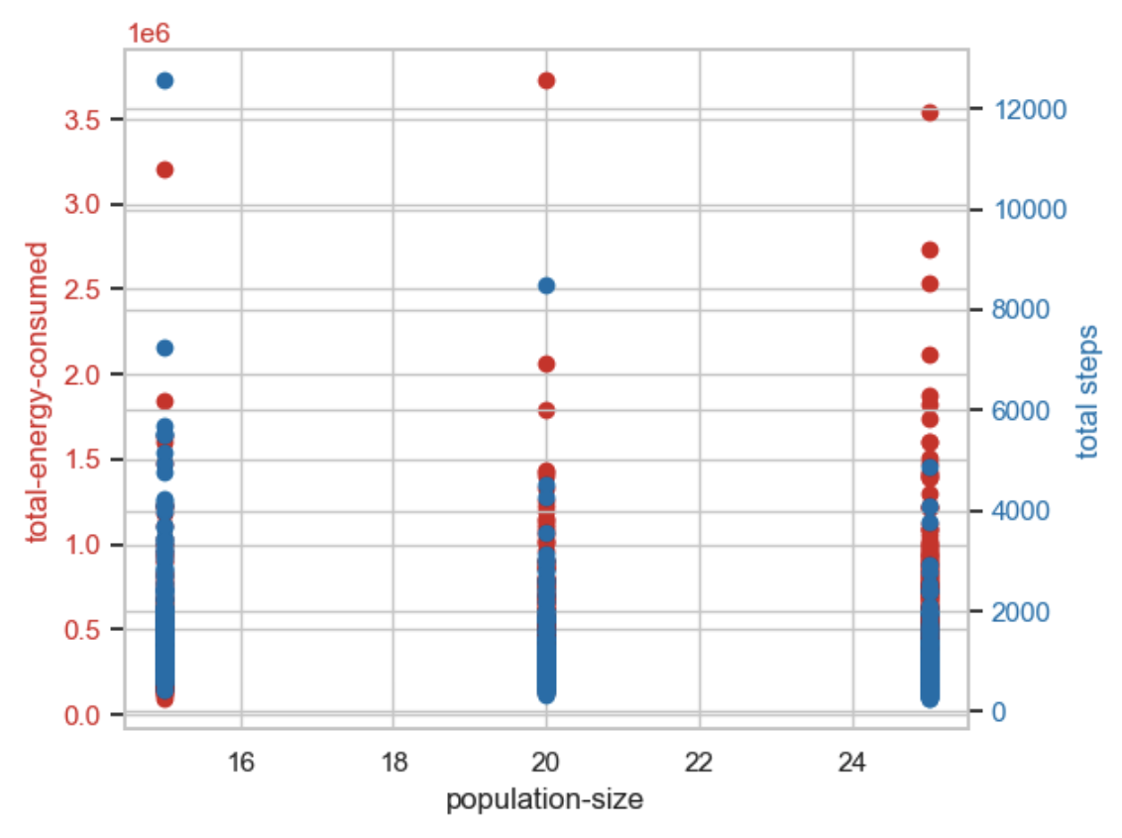
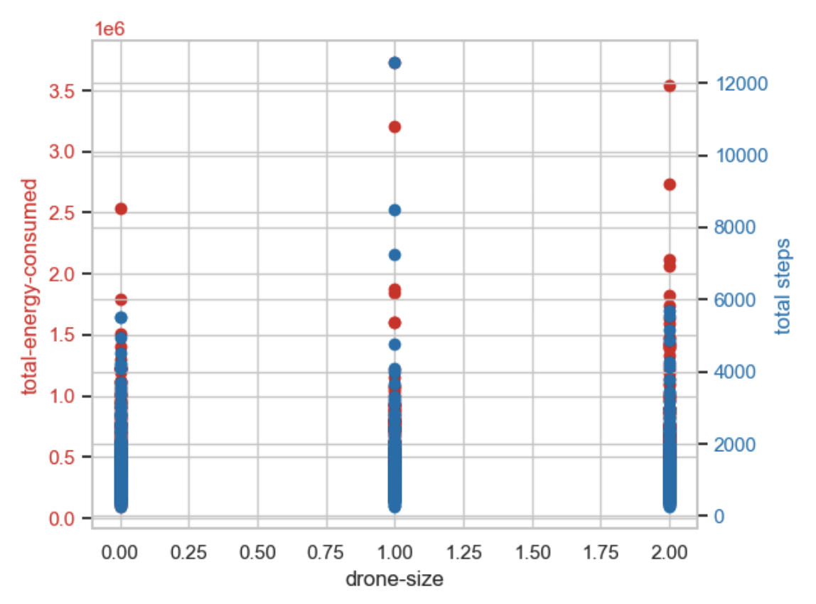
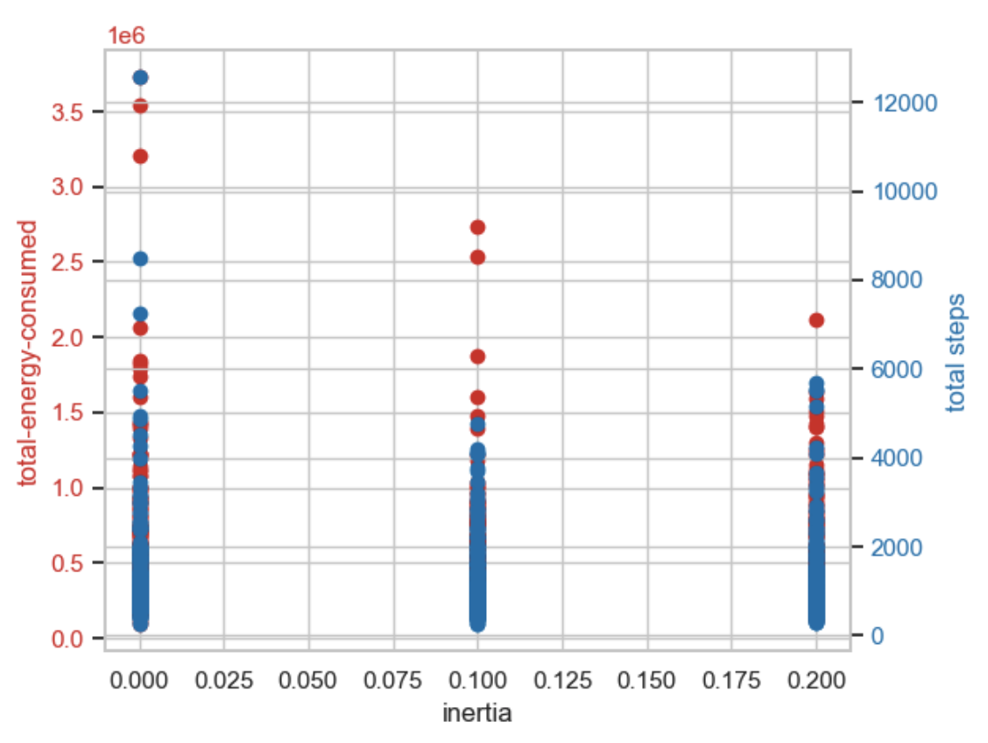
KPI scenario comparison over 729 runs in Behavioral Space (1/2)
As the population of ground robots increase from 15 to 25, the total energy consumed and time (total steps) decrease
As the # of drones increase from 0 to 2, the total energy consumed and time (total steps) increase slightly, which might be due to limited search radius of drones (3x robots)
As the inertia increases from 0 to 0.2, the total energy consumed and time (total steps) decrease

Slide 15
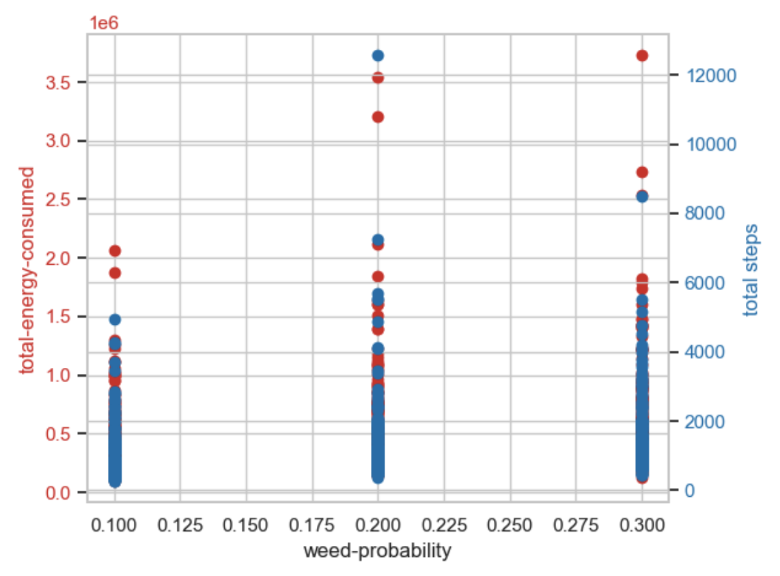
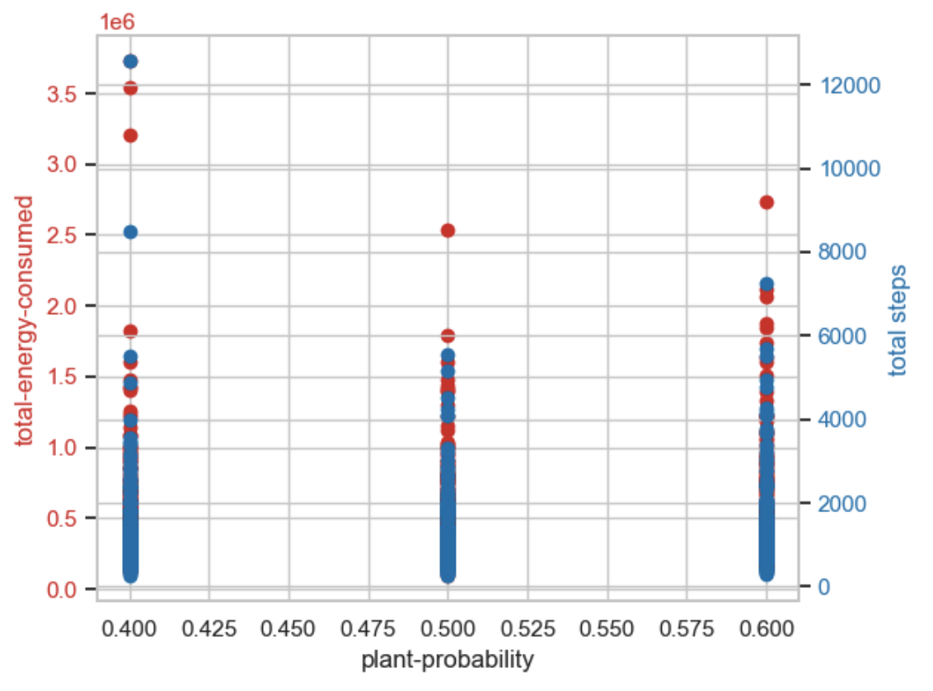
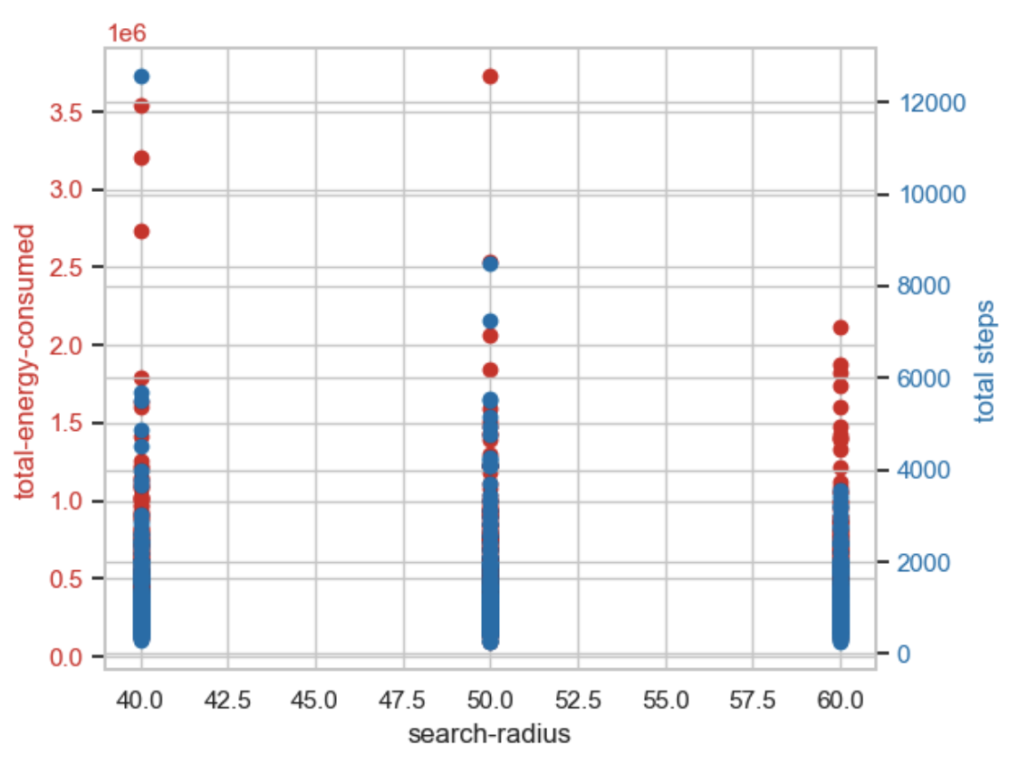
KPI scenario comparison over 729 runs in Behavioral Space (2/2)
As the weed probability increase from 0.1 to 0.3, the total energy consumed and time (total steps) increase
As the plant probability increase from 0.4 to 0.6, the total energy consumed and time (total steps) increase, but few outliers are observed for prob = 0.4
As the search radius increase from 40 to 60, the total energy consumed and time (total steps) decrease as expected

Slide 16
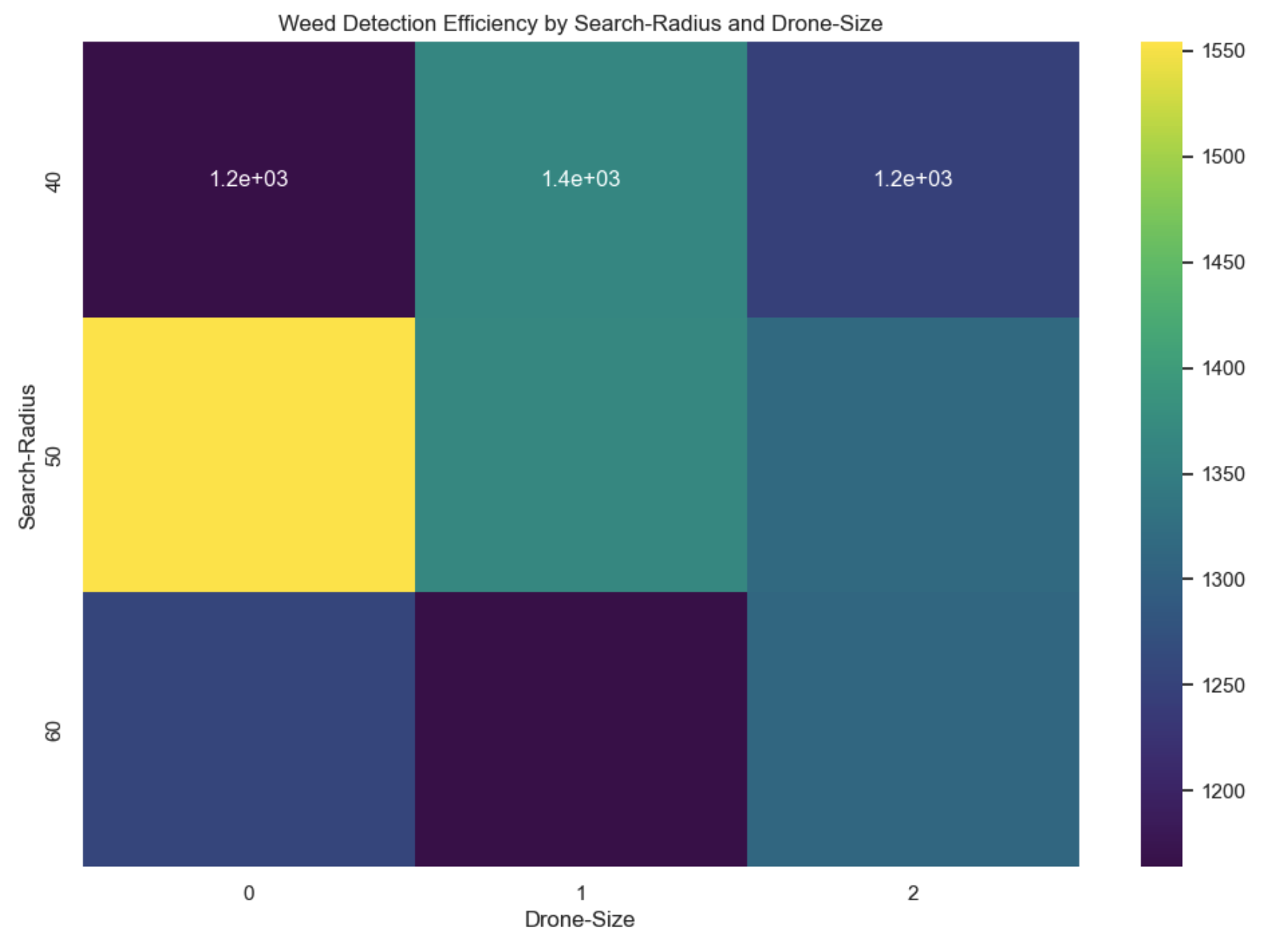
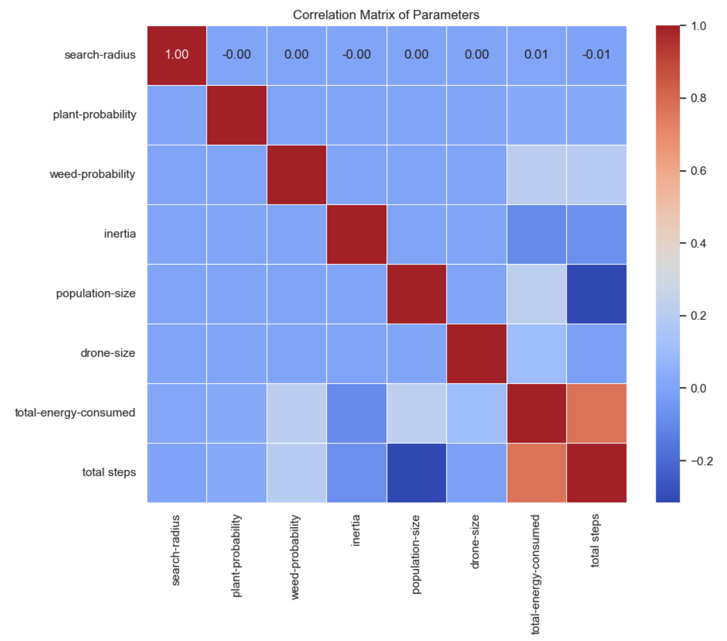
Heatmap and Correlation Matrix of KPIs
Heatmap visualization for optimal combination of search-radius and drone-size suggests having a higher search radius and higher number of drones
Weed-probability and population-size of ground robots have a higher positive correlation with Total-energy-consumed. The population-size is negatively correlated to total steps (time)

Slide 17
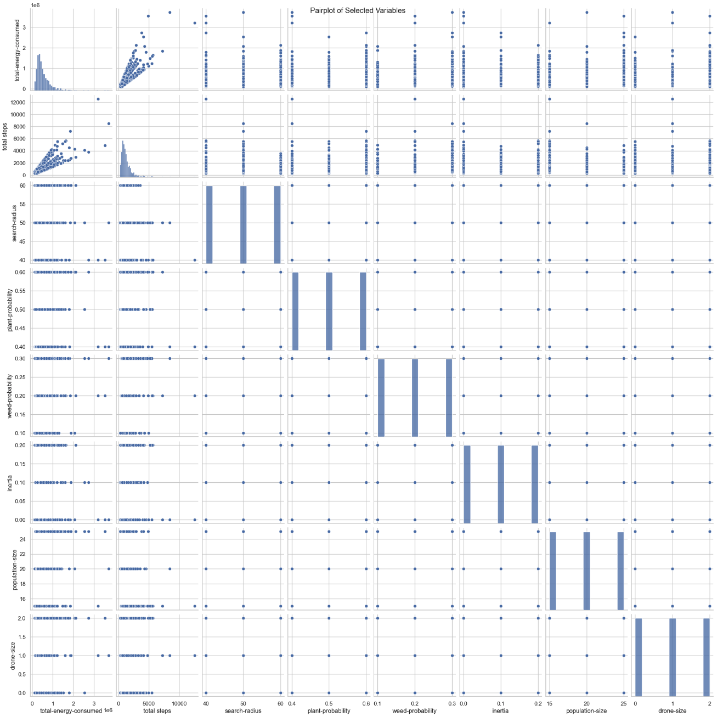
Pairplot of all KPIs used
Pairpolots of all 6 input parameters and the 2 output parameters (energy consumed & time) are as per expectations
Total steps have a positive correlation with Total-energy-consumed
The population-size is negatively correlated to total steps (time)

Slide 18
Conclusion

Slide 19
The final PSO-based algorithm:
successfully achieved the set targets for navigation, coordination of ground robots and drones.
enabled optimized task execution across the farm
identified weeds and simulated their removal
Behaviorspace testing identified trade-offs between search thoroughness, energy efficiency, and robot responsiveness.
Notes:
Our simulation explored the effects of varying search radii, plant probabilities, weed probabilities, inertia values, population sizes, and drone sizes on the efficiency of an agent-based swarm robotics system in a simulated agricultural environment as shown in the table below. We conducted 729 runs to comprehensively understand the impact of these parameters on our system's performance.
Further, PSO algorithm enabled optimized task execution across the farm landscape. Our robots have not just identified weeds but have also simulated their removal, offering a glimpse into the potential of fully automated weed management systems.

Slide 20
Potential Next Steps
Implementing additional (stretch) goals:
Rescue Operations for Stuck Robots
Integrating Aerial Vehicles for Complex Tasks
Advanced Plant Health Monitoring
Algorithmic Improvements
Notes:
This will add to the robustness of our simulation. By enabling robots to assist each other in overcoming obstacles and mechanical failures, we enhance the resilience and autonomy of the swarm as a whole.
We envision incorporating aerial vehicles will bolster the simulation to not just perform surveillance but also carrying out complex actions such as targeted spraying, pollination, or even the transport of smaller ground robots across difficult terrain.
By leveraging machine learning tools like TensorFlow, we can train our agents to not only detect weeds but also identify disease in crops such as soybeans. This advancement would be a significant step toward holistic crop management, where early detection and treatment of disease are critical for yield optimization
From our Behaviorspace experiments, we recognize that an increase in search radius and drone quantity have a proportional effect on the efficiency and optimization of the swarm. By refining the PSO parameters and introducing adaptive mechanisms, we will ensure that our robots not only work smarter but also conserve energy, thus enhancing the sustainability of the operation.

Slide 21
Thank You

Slide 22
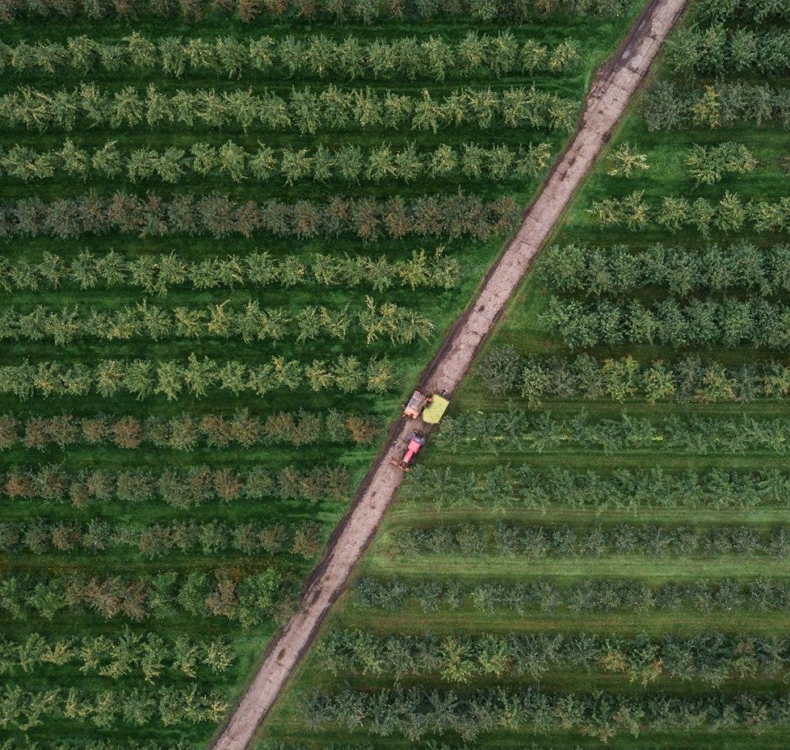
References

Slide 23
Appendix
Literature Review
Albiero, D., Garcia, A., Umezu, C., & Paulo, R. (2022). Swarm robots in Mechanized Agricultural Operations: A review about challenges for research. Computers and Electronics in Agriculture. https://www.sciencedirect.com/science/article/abs/pii/S0168169921006256
Akhloufi, M., & Blais, M. (2023). Reinforcement learning for swarm robotics: An overview of applications, algorithms and simulators. Cognitive Robotics. https://www.sciencedirect.com/science/article/pii/S2667241323000241
Botteghi, N.. & Kamilaris, A., Sinai, L. & Sirmacek, B. (2020). Multi-Agent Path Planning of Robotic Swarms in Agricultural Fields. Annals of Photogrammetry, Remote Sensing and Spatial Information Sciences. V-1-2020. 361-368. 10.5194/isprs-annals-V-1-2020-361-2020.
Bunte, S. (2021). Introducing cooperativeness for agrobotics : An agent-based approach. https://essay.utwente.nl/88141/1/Bunte_MA_BMS.pdf
Calderón-Arce C, Brenes-Torres JC, Solis-Ortega R. Swarm Robotics: Simulators, Platforms and Applications Review. Computation. 2022; 10(6):80. https://doi.org/10.3390/computation10060080
Carbone, C., Garibaldi, O., & Kurt, Z. (2018). Swarm Robotics as a Solution to Crops Inspection for Precision Agriculture. KnE Engineering, 3(2), 552-562. https://doi.org/10.18502/keg.v3i1.1459
Din, A., Ismail, M., Shah, B., Babar, M., Ali, F., & Baig, S. (2022). A deep reinforcement learning-based multi-agent area coverage control for Smart Agriculture. Computers and Electrical Engineering. https://www.sciencedirect.com/science/article/abs/pii/S0045790622003445
Kiani F, Seyyedabbasi A, Nematzadeh S, Candan F, Çevik T, Anka FA, Randazzo G, Lanza S, Muzirafuti A. (2022). Adaptive Metaheuristic-Based Methods for Autonomous Robot Path Planning: Sustainable Agricultural Applications. Applied Sciences. https://doi.org/10.3390/app12030943
Kuhlmann, S. (2021). Adaptive swarm robotics could revolutionize smart agriculture. Texas A&M Today. https://today.tamu.edu/2021/11/15/adaptive-swarm-robotics-could-revolutionize-smart-agriculture/
Olaronke, I., Rhoda, I., Gambo, I., Oluwaseun, O., & Janet, O. (2020). A Systematic Review of Swarm Robots. Current Journal of Applied Science and Technology, 39(15), 79–97. https://doi.org/10.9734/cjast/2020/v39i1530719
Rosenberger, C., Arguenon, V., & Bergues-Lagarde, A. (2006). Multi-agent based prototyping of Agriculture Robots. International Symposium on Collaborative Technologies and Systems (CTS’06). https://www.academia.edu/55634151/Multi_Agent_Based_Prototyping_of_Agriculture_Robots
Tian, H., Wang, T., Liu, Y., Quiao, X., & Li, Y. (2019, September 27). Computer Vision Technology in Agricultural Automation -A Review. Information Processing in Agriculture. https://www.sciencedirect.com/science/article/pii/S2214317319301751#b0175
Saga - Swarm Robotics for agricultural applications. (2019. The European Coordination Hub for Open Robotics Development. https://echord.eu/saga.html

Slide 24
Appendix
Data sets
Altaheri, H., Alsulaiman, M., Muhammad, G., Amin, S., Bencherif, M., & Mekhtiche, M. (2019, September 18). Date fruit dataset for intelligent harvesting. Data in Brief. https://www.sciencedirect.com/science/article/pii/S2352340919308698?via%3Dihub
Haug, S. cwfid/dataset: A Crop/Weed Field Image Dataset. GitHub. https://github.com/cwfid/dataset
Menber, J. josemenber/image-based-crop-anomaly-detection: A Convolutional Neural Network approach for image-based anomaly detection in smart agriculture. GitHub. https://github.com/josemenber/image-based-crop-anomaly-detection
Olsen, A. Alexolsen/deepweeds: A multiclass weed species image dataset for deep learning. GitHub. https://github.com/AlexOlsen/DeepWeeds
Plant_disease_resnet50. Kaggle. https://www.kaggle.com/code/aryanml007/plant-disease-resnet50/notebook
Rice Classification ~99.2% Accuracy. Kaggle. https://www.kaggle.com/code/mushfirat/rice-classification-99-2-accuracy/comments
Sa, I. (2019). DeepFruits_dataset. Google Drive. https://drive.google.com/drive/folders/1CmsZb1caggLRN7ANfika8WuPiywo4mBb
Weed detection in soybean crops. Kaggle. (2018, September 12). https://www.kaggle.com/datasets/fpeccia/weed-detection-in-soybean-crops
Petruk, I. Agricultural Robotics drivers and trends. Infopulse. https://www.infopulse.com/blog/agricultural-robotics-drivers-trends#:~:text=The%20agricultural%20robotics%20sector%20is,annual%20growth%20rate%20of%2024.3%25.
AI tools such as ChatGPT, Gemini, Co-pilot

